Slide 1
Cross-Subject Motor Imagery
EEG Classification
SOLUTION DESIGN
A small hybrid CNN–Transformer that has to work for people it has never seen
TEAM
Ananya Gourishetty · Haarika D · Siddhanth Samal · Sathvik P
GUIDE
COURSE
Dr. Mohan Allam
CSE4006 Deep Learning · Group 5
School of Computer Science and Engineering, VIT-AP University
Notes:
We are Group 5: Ananya, Haarika, Siddhanth and Sathvik, guided by Dr. Mohan Allam. This is our solution design. The short version: we want to decode imagined movements from EEG for a person the model has never seen, and we want to do it with a small model. The next slides cover why that is hard, what others have tried, what we will build, and how we will test it fairly.

Slide 2
What we will cover
OVERVIEW
01
02
03
The problem
The data
What others have tried
Why decoders that work for familiar people fail on someone new
BCI Competition IV 2a: nine people, four imagined movements
Four published models, what each gives us, and the gap they leave
04
05
06
Our design
How we test it
Plan
HCT-Net, the preprocessing pipeline and Euclidean alignment
Leave-one-subject-out, the metrics, and six experiments
An 18-day build, the risks, and what we expect to learn
Notes:
Here is the route through the talk. We start with the problem and the data, look at what published models have achieved and where they fall short, then walk through our design, how we will test it, and how we will build it.

Slide 3
Accuracy collapses on a new person
01 · THE PROBLEM
A motor-imagery BCI turns imagined movements into commands, for example for someone who can no longer move their hands.
Today, every new user first sits through a long labelled calibration session. Skip it, and accuracy falls sharply.
Our goal: a decoder that works on a person it has never seen.
82.5%
58.6%
when the person was
part of training
on a person it
has never seen
−23.9 points
CTNet on BCI IV-2a, four classes (Zhao et al., 2024). Chance is 25%.
Notes:
This is the number behind the whole project. CTNet, one of the strongest recent models, gets 82.52% on four classes when the test person was part of training. Hold that person out and it falls to 58.64%, almost 24 points lower. The second number is what a new user would actually get. On the two-class BCI IV-2b data the drop is 12.22 points, so this is not a one-off. That is why every new user records a long calibration session today, and that session is what we want to make unnecessary.

Slide 4
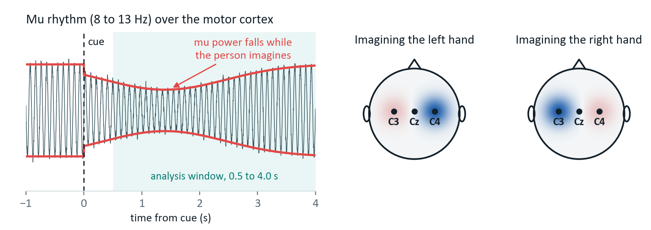
What the decoder has to pick up
01 · THE PROBLEM
Imagine moving your left hand and the 8–13 Hz rhythm over the right side of your head gets weaker. Right hand, left side. The decoder has to find that drop inside very noisy signals.
µV
Tiny signal
288
Little data
9
Every head differs
A few millionths of a volt, mixed with eye, muscle and mains noise.
labelled trials per session, yet one trial is 22 × 875 numbers.
people, each with their own skull, cap fit and way of imagining.
Notes:
What does the decoder look for? When you imagine moving a hand, the mu rhythm, around 8 to 13 Hz, weakens over the motor cortex on the opposite side. This is called event-related desynchronisation. Three things make it hard to read: the signal is tiny and buried in noise from the eyes and muscles, there is very little labelled data, and every head is different, so the same imagined movement looks different from one person to the next. That last problem is the one we are going after.

Slide 5
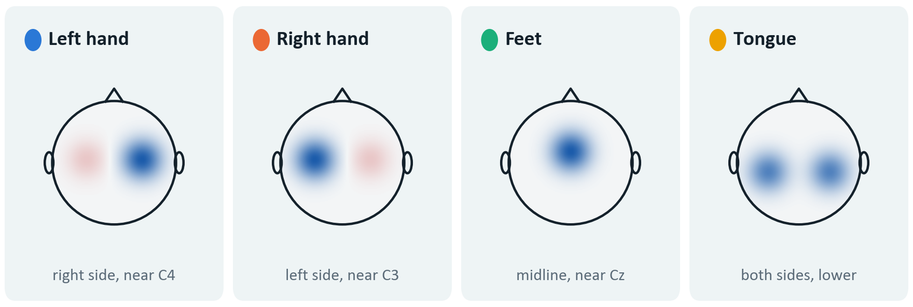
Our data: 9 people, 4 imagined movements
02 · THE DATA
9
people, A01 to A09
22
EEG electrodes; 3 eye channels dropped
250 Hz
sampling rate
2
sessions each, on different days
BCI Competition IV dataset 2a, recorded at Graz University of Technology. We chose it because all four papers we build on report results on it, so our re-runs can be checked against their published numbers.
Nine people gives nine leave-one-out folds: enough for a mean, a spread and a paired test, but too few to trust any single fold on its own.
5,184
labelled trials in total
25%
chance level, as the four classes are balanced
Notes:
We use BCI Competition IV dataset 2a from Graz. Nine people, 22 electrodes, four imagined movements: left hand, right hand, both feet and tongue. Each person did two sessions on different days with 288 trials each, so 5,184 trials in total. The classes are perfectly balanced, which puts chance at 25%. We picked this dataset because all four papers we build on report on it, so we can check our versions of their models against their numbers. Nine people also limits what we can claim, and we keep that in mind throughout.

Slide 6
We read 3.5 seconds of imagery per trial
02 · THE DATA
3.5 s window = 875 samples
Fixation cross
and beep
Arrow
cue
Imagining the movement
Rest
0 s
1 s
2 s
3 s
4 s
5 s
6 s
7 s
Why start 0.5 s after the arrow?
That first half-second is mostly the brain reacting to seeing the arrow. A model could learn that reaction and still know nothing about imagined movement.
Why stop at 6 s?
The imagery period ends there. The window gives 875 samples per electrode at 250 Hz, for every model alike.
Notes:
Each trial follows the same timeline. A fixation cross and a beep, then at two seconds an arrow tells the person which movement to imagine, and they keep imagining it until about six seconds. We take the window from 0.5 to 4 seconds after the arrow: 3.5 seconds, or 875 samples per electrode. We skip the first half-second on purpose. That part is mostly the brain’s response to seeing the arrow, and a model could learn the arrow instead of the imagery.

Slide 7
Bigger models don’t fix the new-person problem
03 · WHAT OTHERS HAVE TRIED
chance 25%
EEG Conformer has 219 times EEGNet’s parameters and scores 3.4 points lower. The best of the five is only 3.3 points ahead.
Leave-one-subject-out accuracy reported by Zhao et al. (2024); + marks models the CTNet authors re-ran under the same protocol. Parameter counts: braindecode reference models at our 875-sample input. Chance is 25%.
Notes:
This is what published work tells us. On the left is model size on a log scale, from about 3,000 to about 700,000 parameters. On the right is accuracy on a person held out of training, all measured by the CTNet authors under one protocol. Size grows more than two hundred times, but accuracy stays between 53 and 60 percent, and the biggest model is actually the lowest. So more capacity is not what fixes the new-person problem, and that shaped our whole design: keep the model small and deal with the differences between people in the data.

Slide 8
What we take from each paper
03 · WHAT OTHERS HAVE TRIED
2018
2023
2023
2024
EEGNet
ATCNet
EEG Conformer
CTNet
Compact CNN
CNN + attention + TCN
CNN + Transformer
CNN + Transformer
3,188 parameters
113,732 parameters
697,412 parameters
152,364 parameters
Learns frequency filters, then spatial filters, with very few weights.
Applies attention inside sliding windows of the feature sequence.
Convolution for local detail, then a Transformer across the trial.
An EEGNet front end feeding a six-layer Transformer encoder.
WE TAKE
WE TAKE
WE TAKE
WE TAKE
the whole convolutional front end
attention inside short windows
convolution first, attention after
the encoder design, cut to two layers
None of the four is small, accurate and reliable on new people at the same time. That is the gap we work on.
Notes:
We build on four papers and take one thing from each. From EEGNet, the convolutional front end, which learns frequency and spatial filters with very few weights. From ATCNet, the idea of running attention inside short windows. From EEG Conformer and CTNet, the order: convolution first, a Transformer after it. And from CTNet the encoder itself, cut from six layers to two. None of these models is small, accurate and reliable on new people at once. That is the gap.

Slide 9
What we set out to do
04 · OUR DESIGN
1
Build one reproducible pipeline for BCI IV-2a, from raw files to results.
THE QUESTION BEHIND ALL FIVE
Can a model with about 21,000 parameters hold its own against much larger ones on a person it has never seen?
2
Re-run EEGNet, ATCNet, EEG Conformer, CTNet and FBCSP under one identical protocol.
3
Design HCT-Net: small, hybrid, and built for people it has never seen.
4
Test every model only on unseen people, with leave-one-subject-out.
5
Report every result, including the ones that go against us.
Notes:
These are our five objectives. The one we care most about is the fourth: every number we report is measured on someone the model never saw. The fifth is a promise: if our model does not beat the baselines we still report it, and the component study tells us why. Underneath it all is one question: can a model of about twenty-one thousand parameters hold its own against much larger ones on a new person?

Slide 10
HCT-Net in one picture
04 · OUR DESIGN
Raw EEG
Preprocessing
CNN front end
Windowed attention
Pool and classify
Prediction
22 electrodes
250 Hz
filter, cut,
align, scale
temporal, spatial,
separable conv
2 encoder layers
over 5 windows
average, then
a linear layer
left, right,
feet or tongue
Taken from published work
alignment from
He & Wu
from EEGNet
from ATCNet, CTNet,
EEG Conformer
What is borrowed
Every block comes from published work: the front end from EEGNet, windowed attention from ATCNet, convolution then Transformer from EEG Conformer and CTNet, and alignment from He and Wu.
What is ours
Putting them together at this size for a 5,184-trial dataset, cutting attention to two layers, testing every model the same way, and measuring what each part adds.
Notes:
This is the whole system. Raw EEG is filtered, cut into trials, aligned and scaled. The CNN front end, taken from EEGNet, learns frequency and spatial filters. A small Transformer then looks across time inside five overlapping windows. We average, classify, and output one of four movements. Only the two coloured blocks have trainable weights. Nothing here is a new invention. What is ours is how the pieces are combined and sized for a dataset this small, and the fact that every model gets exactly the same treatment.

Slide 11
Inside HCT-Net: 20,996 parameters
04 · OUR DESIGN
Input
Temporal conv
Spatial conv
Separable conv
Transformer × 2
Average + linear
22 electrodes ×
875 samples
16 filters, each
64 samples long
2 filters per band
across 22 electrodes
plus pooling
÷4, then ÷8
5 windows of 11,
2 heads, width 32
softmax over
four classes
22 × 875
16 × 22 × 875
32 × 1 × 875
32 × 27
5 × 32 × 11
4
Where the 20,996 parameters go
3,424
17,088
Convolution (16%)
Transformer encoder (81%)
positions 352 + classifier 132
Why two encoder layers, not CTNet’s six?
Six layers at this width would put 51,264 parameters in attention alone, more than our whole budget of 50,000.
Why keep it this small?
Each fold trains on only 4,032 trials. Every extra weight is another chance to memorise the seven training people instead of learning what they share.
Notes:
Inside the model. A trial is 22 electrodes by 875 samples. Sixteen temporal filters, each 64 samples or about a quarter of a second, act like learned band-pass filters. A depthwise spatial layer gives each band two spatial filters across all electrodes, a learned version of CSP. A separable convolution and two pooling steps shrink time from 875 to 27 steps. The Transformer then works inside five overlapping windows of 11 steps. In total that is 20,996 parameters, and 81% of them sit in the encoder, which is why we stopped at two layers.

Slide 12
Small, but not the smallest
04 · OUR DESIGN
1/5
the size of ATCNet
1/33
the size of EEG Conformer
6.6×
the size of EEGNet, our smallest baseline
Counts from the braindecode 1.8.1 reference implementations: 22 channels, 4 classes, 875-sample input.
Notes:
In context, HCT-Net is about one fifth the size of ATCNet and one thirty-third the size of EEG Conformer. It is not the smallest, though. EEGNet is six and a half times smaller, and it is the baseline we most need to beat. If HCT-Net cannot beat EEGNet on new people, the extra attention is not earning its parameters, and we will say so.

Slide 13
One preprocessing pipeline for every model
04 · OUR DESIGN
1
Keep 22 channels
2
Band-pass 4–38 Hz
3
Cut the trial
4
Reject artefacts
Drop the 3 eye channels after using them to spot artefacts.
Run forwards and backwards, so nothing shifts in time.
0.5 to 4.0 s after the cue: 875 samples.
Any channel swinging more than 100 µV peak to peak.
5
Align each session
6
Standardise
7
Augment
8
Cache
Euclidean alignment, using only unlabelled trials.
Means and spreads from the training people only.
Stitch 8 segments from same-class trials. Training only.
Write once, reuse for every model and every fold.
The test person’s labels are never used. Their unlabelled trials go into one place only: their own alignment in step 5.
Notes:
Every model goes through the same eight preprocessing steps, so any difference in results comes from the models and not from how the data was handled. A few details matter. The filter runs forwards and backwards, so it does not shift the signal in time. Standardisation uses statistics from the training people only. Augmentation makes new training trials by stitching together eight segments from different trials of the same class, and it never touches validation or test data.

Slide 14
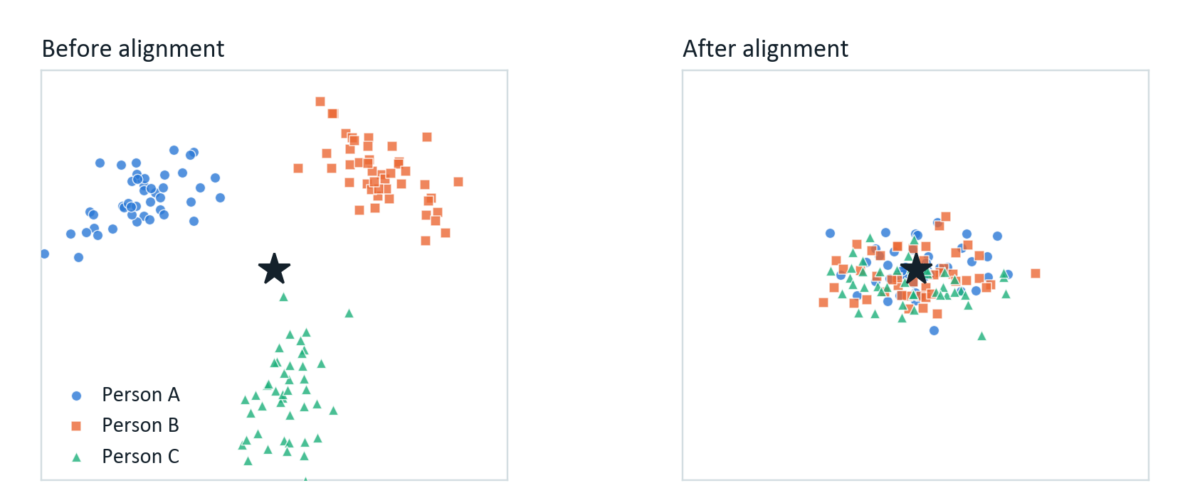
Alignment puts every person in one frame
04 · OUR DESIGN
For each person
1
Average the covariance of all their trials. Call it R.
2
Multiply every trial by R^{−1/2}.
3
Now their average covariance is the identity, the star in the picture.
Illustration, not measured data.
So a new user only has to wear the cap and record a few unlabelled trials. That is enough to align them before the model sees anything.
✓ needs no labels
✓ adds zero parameters
✓ costs one 22 × 22 eigen-decomposition
Notes:
Euclidean alignment, from He and Wu, is the step we expect to do most of the work against the new-person problem. For each person we average the covariance matrices of their trials, then multiply every trial by the inverse square root of that average. Afterwards everyone's average covariance is the identity, so the model no longer has to learn each person’s head shape and cap position. It needs no labels and adds no parameters, so it works for a brand-new user. We will check it in code: after alignment the average covariance must equal the identity within a small tolerance.

Slide 15
Every test is on a person the model never saw
05 · HOW WE TEST IT
A01
A02
A03
A04
A05
A06
A07
A08
A09
What we measure
Accuracy per person, mean and spread
Cohen’s kappa, which corrects for chance
Macro precision, recall and F1
Confusion matrix, to catch feet vs tongue
Size, training time and inference time
How we decide a difference is real
Wilcoxon signed-rank test over the nine people, Holm correction across the five comparisons, and three random seeds for every setting.
Fold 1
test
val
Fold 2
test
val
Fold 3
test
val
Fold 4
test
val
Fold 5
test
val
Fold 6
test
val
Fold 7
test
val
Fold 8
test
val
Fold 9
val
test
In every fold, 7 people train, 1 validates and 1 is tested. The roles rotate.
Notes:
This is how we test. Nine folds, one per person. In each fold one person is the test person, the next is used for validation, and the other seven train the model. Everyone is the test person exactly once. We use a separate validation person rather than a random split, because a split would tune the model towards people it already knows. We also run every model within subject, session one to session two, only as a sanity check against published numbers. The Wilcoxon test with Holm correction decides whether a difference is real.

Slide 16
Six experiments, one question each
05 · HOW WE TEST IT
runs
E4: switch one part off at a time
E1
Baselines within subject
Do our versions match their papers?
45
Variant | Conv | Attention | Alignment | Augment
V0 full model | ✓ | ✓ | ✓ | ✓
V1 no attention | ✓ | ✕ | ✓ | ✓
V2 global attention | ✓ | global | ✓ | ✓
V3 no alignment | ✓ | ✓ | ✕ | ✓
V4 no augmentation | ✓ | ✓ | ✓ | ✕
V5 convolution only | ✓ | ✕ | ✕ | ✕
E2
Baselines on unseen people
How do they do under one protocol?
45
E3
HCT-Net on unseen people
How does our model do?
9
E4
Component study
Which parts actually matter?
45
E5
Attention depth
Are two layers enough, or do six help?
9
E6
Size and speed
Is HCT-Net really lighter?
—
Every variant is trained and tested exactly like the full model, so a change in accuracy belongs to the part that was switched off.
153 runs per seed, three seeds each. E6 is measured during E2 and E3.
Notes:
Six experiments, each answering one question. E1 checks that our versions of the baselines reproduce their papers’ within-subject numbers; if they do not, nothing after it can be trusted. E2 and E3 are the main comparison on unseen people. E4 switches parts of HCT-Net off one at a time. E5 tests two encoder layers against six. E6 measures size and speed. That is 153 training runs for each seed, and every setting gets three seeds.

Slide 17
An 18-day build, checked at every step
06 · PLAN
Dataset preparation and checks
3 days
Preprocessing pipeline
2 days
Baselines built and reproduced
4 days
HCT-Net implemented
3 days
Training set-up and tuning
2 days
Leave-one-subject-out runs
2 days
Comparison and statistics
1 day
Report and figures
1 day
day
1
4
6
10
13
15
17
18
Nothing trains until the alignment check passes.
HCT-Net is written only after two baselines match their papers.
No leave-one-subject-out run starts until the folds are checked.
Notes:
The build has eighteen days, and the order is deliberate. Data checks and preprocessing come first, then the baselines, and only then our own model, because a new model on an unchecked pipeline cannot be interpreted. Three rules protect the plan. Code can be written faster under pressure; training runs cannot, so the compute-heavy stages sit at the end with as few open questions as possible. Each stage ends in a milestone with a pass-or-fail check.

Slide 18
What could go wrong, and what we will do
06 · PLAN
RISK
WHY IT COULD HAPPEN
WHAT WE WILL DO
Too little data
5,184 trials in all; about 4,032 per training fold
Augmentation, dropout, early stopping and a deliberately small model
Baselines miss their papers
Each paper used its own preprocessing and protocol
Use the authors’ reference code and report both numbers side by side
Nine people, wide spread
Some people produce only weak rhythms
Per-person results, standard deviations and paired tests, not just means
Not enough GPU time
153 runs per seed, three seeds each
Cached data, mixed precision and a checkpoint every epoch
HCT-Net does not win
The combination may not help on this dataset
Report it plainly; the component study shows why
Notes:
Five things could go wrong, and each has a planned response. The dataset is small, so we regularise and keep the model small. Baselines may not match their papers, so we use the authors’ own code and report both numbers. Nine people can give a wide spread, so we report per person and use paired tests. GPU time is limited, so we cache data, use mixed precision and checkpoint every epoch. And HCT-Net may simply not win, in which case we say so and use the component study to explain why.

Slide 19
What we expect, and what is new
06 · PLAN
WE EXPECT
not yet measured
Accuracy on new people that holds up against much bigger models
All of it at 20,996 parameters, about a fifth of ATCNet
Less need for a long calibration session
A clear answer either way, with the component study explaining it
WHAT IS NEW
All four architectures compared under one leave-one-subject-out protocol
A compact combination with attention sized for 5,184 trials
A component study on unseen people, which the four papers do not report
Accuracy weighed against model size under a single protocol
No single block is new. What we add is the combination, the fair protocol and the measurement.
Notes:
What we expect, stated as expectations because nothing has been run yet: accuracy on new people that holds up against bigger models, at about twenty-one thousand parameters, and less need for calibration. What is new is modest and specific: one fair comparison of all four architectures under a single leave-one-subject-out protocol, a compact combination sized for this dataset, a component study on unseen people, and accuracy measured against size. If the result is negative, it is still a result, and we will report it.

Slide 20
Key references
REFERENCES
[1] Lawhern et al., “EEGNet: a compact convolutional neural network for EEG-based brain–computer interfaces,” J. Neural Eng., 2018.
[2] Altaheri et al., “Physics-informed attention temporal convolutional network for EEG-based motor imagery classification,” IEEE Trans. Ind. Informatics, 2023.
[3] Zhao et al., “CTNet: a convolutional transformer network for EEG-based motor imagery classification,” Scientific Reports, 2024.
[4] Song et al., “EEG Conformer: convolutional transformer for EEG decoding and visualization,” IEEE Trans. Neural Syst. Rehabil. Eng., 2023.
[5] Tangermann et al., “Review of the BCI Competition IV,” Frontiers in Neuroscience, 2012.
[6] Brunner et al., “BCI Competition 2008 – Graz data set A,” Graz University of Technology, 2008.
[7] He and Wu, “Transfer learning for brain–computer interfaces: a Euclidean space data alignment approach,” IEEE Trans. Biomed. Eng., 2020.
[8] Schirrmeister et al., “Deep learning with convolutional neural networks for EEG decoding and visualization,” Human Brain Mapping, 2017.
[9] Ang et al., “Filter bank common spatial pattern (FBCSP) in brain–computer interface,” Proc. IJCNN, 2008.
[10] Vaswani et al., “Attention is all you need,” NeurIPS, 2017.
[11] Gramfort et al., “MEG and EEG data analysis with MNE-Python,” Frontiers in Neuroscience, 2013.
[12] Aristimunha et al., “Mother of All BCI Benchmarks (MOABB),” 2023.
[13] Pfurtscheller and Lopes da Silva, “Event-related EEG/MEG synchronization and desynchronization,” Clinical Neurophysiology, 1999.
[14] Holm, “A simple sequentially rejective multiple test procedure,” Scandinavian Journal of Statistics, 1979.
[15] Wilcoxon, “Individual comparisons by ranking methods,” Biometrics Bulletin, 1945.
Notes:
These are the sources behind every number and every borrowed idea in this talk. The full references, with volumes and pages, are in the solution design document.

Slide 21
Thank you
Questions are welcome
Next: the pipeline and baselines first, then HCT-Net, then the leave-one-subject-out experiments.
Group 5 · Ananya Gourishetty, Haarika D, Siddhanth Samal, Sathvik P
Notes:
Thank you. Next comes the build: the pipeline and the baselines first, then HCT-Net, then the experiments. We are happy to take questions.

